Slide 1

TRINITY INSTITUTE
OF
MANAGEMENT AND TECHNOLOGY JALANDHAR
COLLEGE CABINET
2026-27

Slide 2
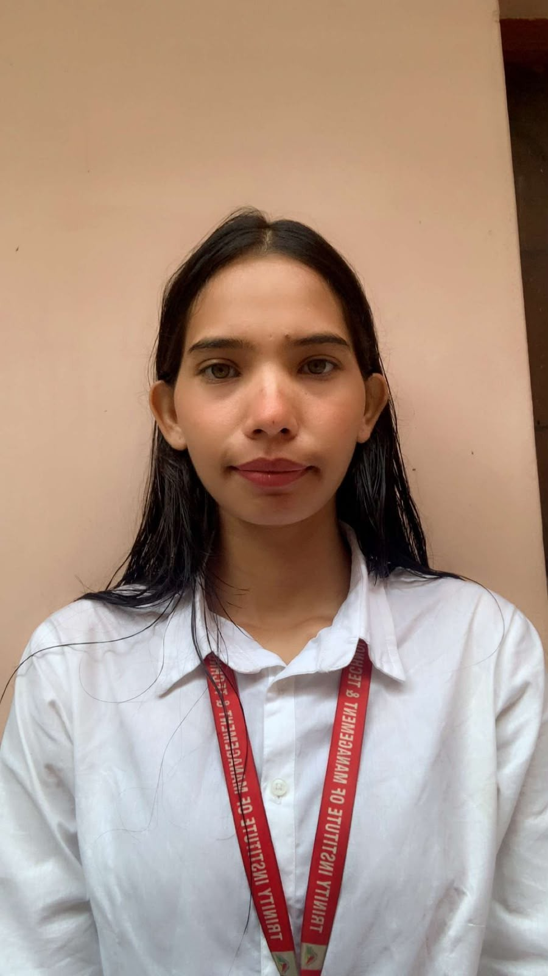
PRESIDENT
NAME – CHRISTINA
CLASS- BMLS
SEMESTER- 5th

Slide 3
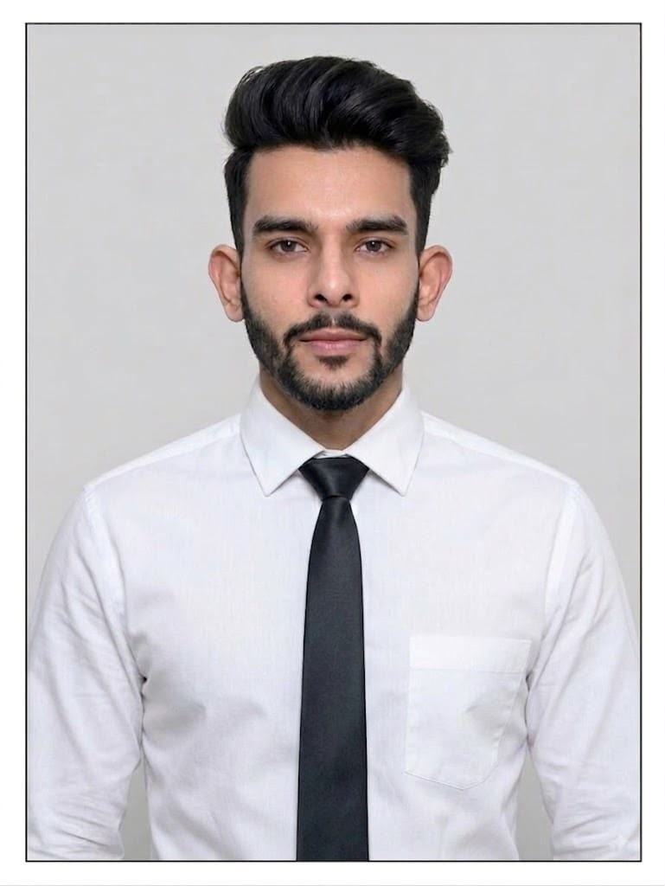
VICE PRESIDENT
NAME – YAKSH
CLASS- BHMCT
SEMESTER – 7th

Slide 4
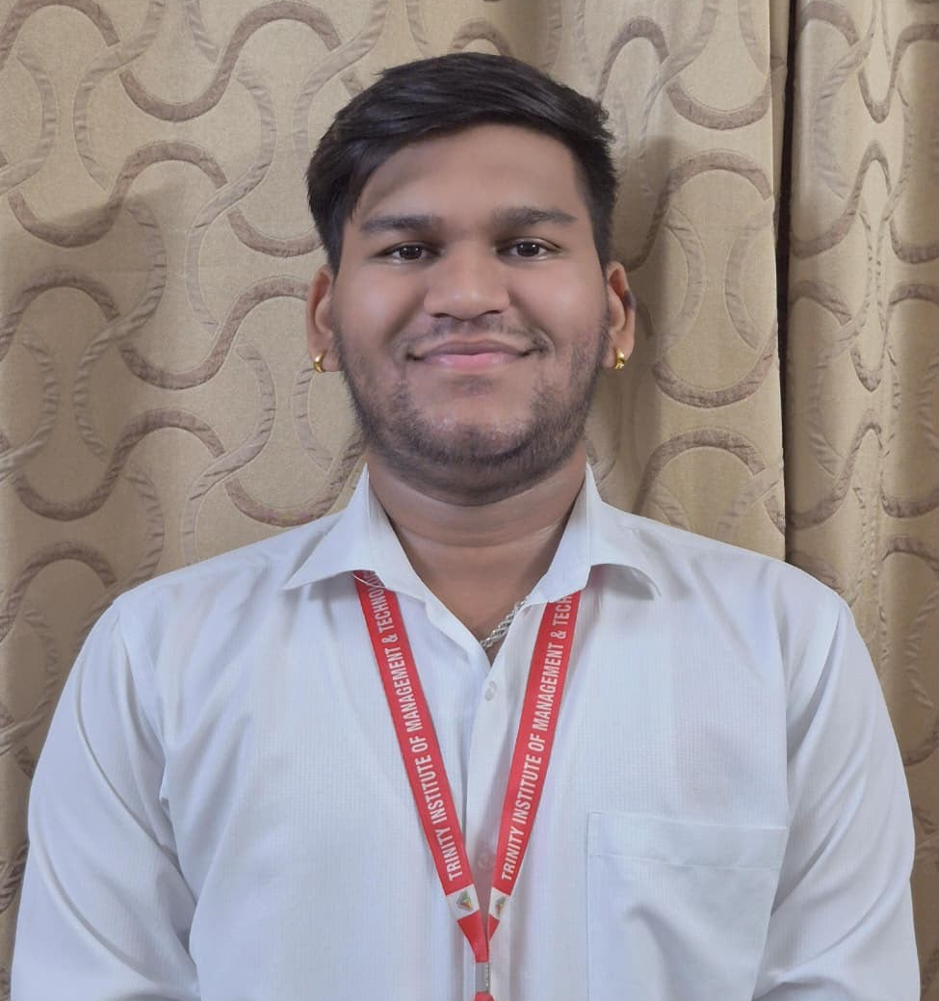
SECRETARY
NAME – AADITYA
CLASS – BBA
SEMESTER – 3rd

Slide 5
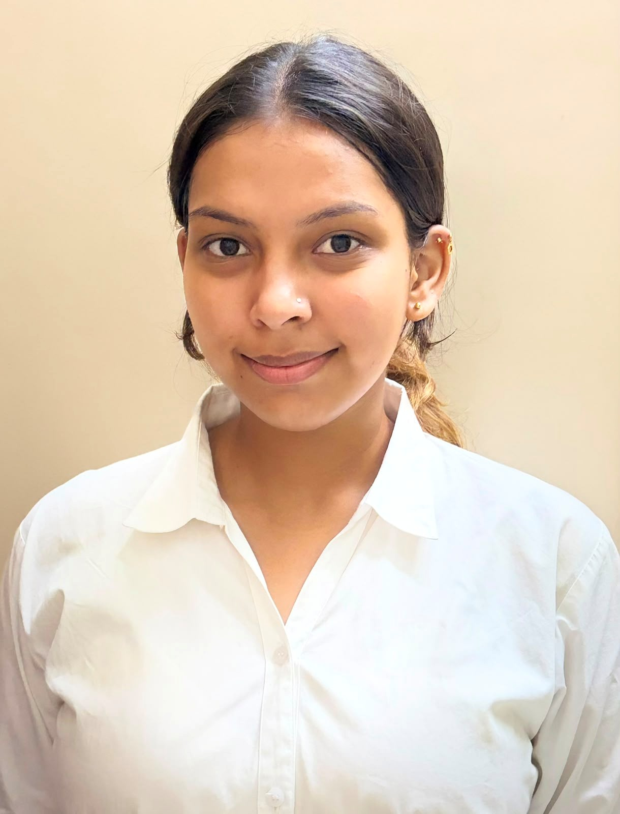
JOINT SECRETARY
NAME – NIKITA
CLASS – BBA
SEMESTER - 5th

Slide 6
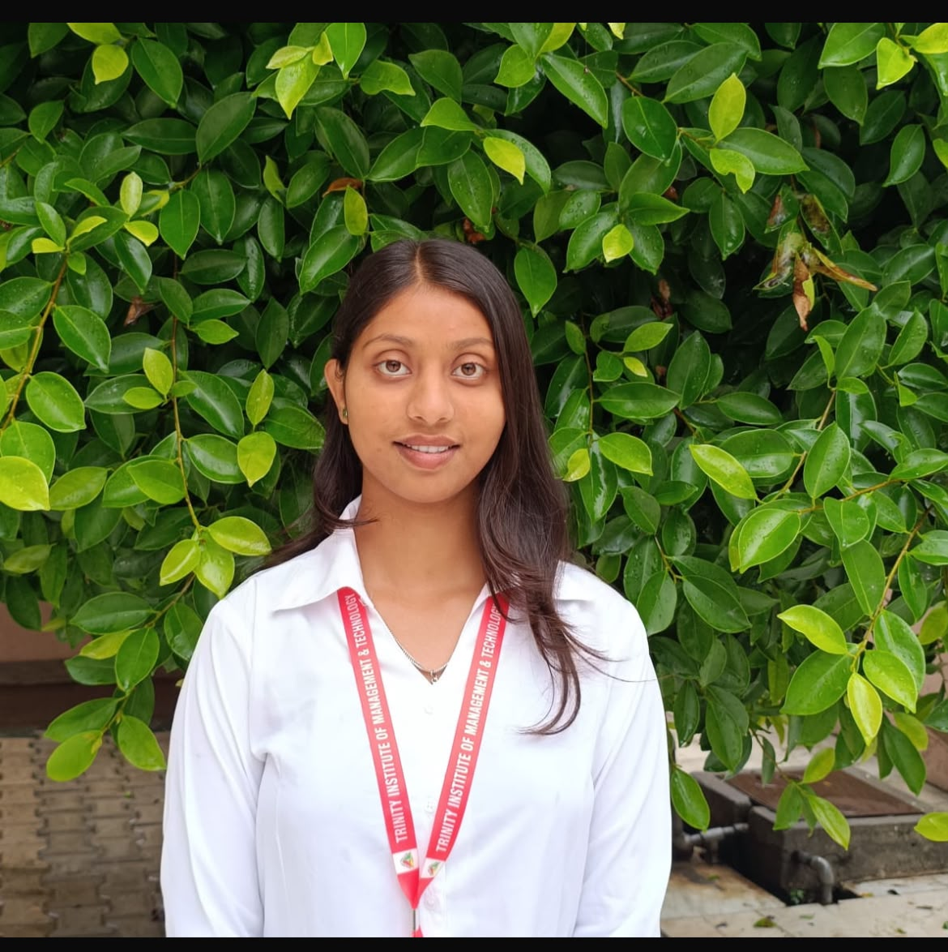
DISCIPLINE COORIDINATOR
NAME – SONIA
CLASS – BSc MLS
SEMESTER - 3rd

Slide 7
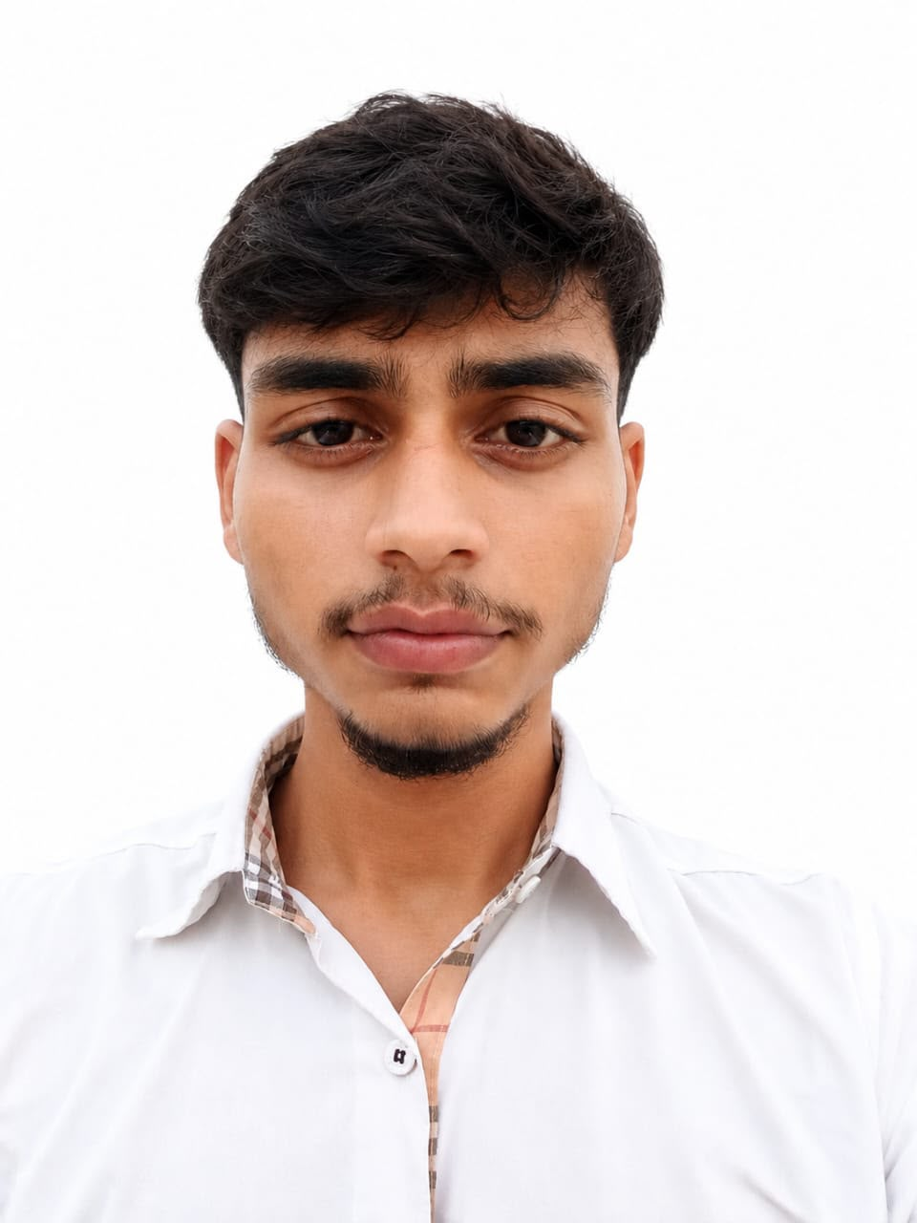
SPORTS COORIDINATOR
NAME – LOVEPREET
CLASS – BBA
SEMESTER - 5th

Slide 8
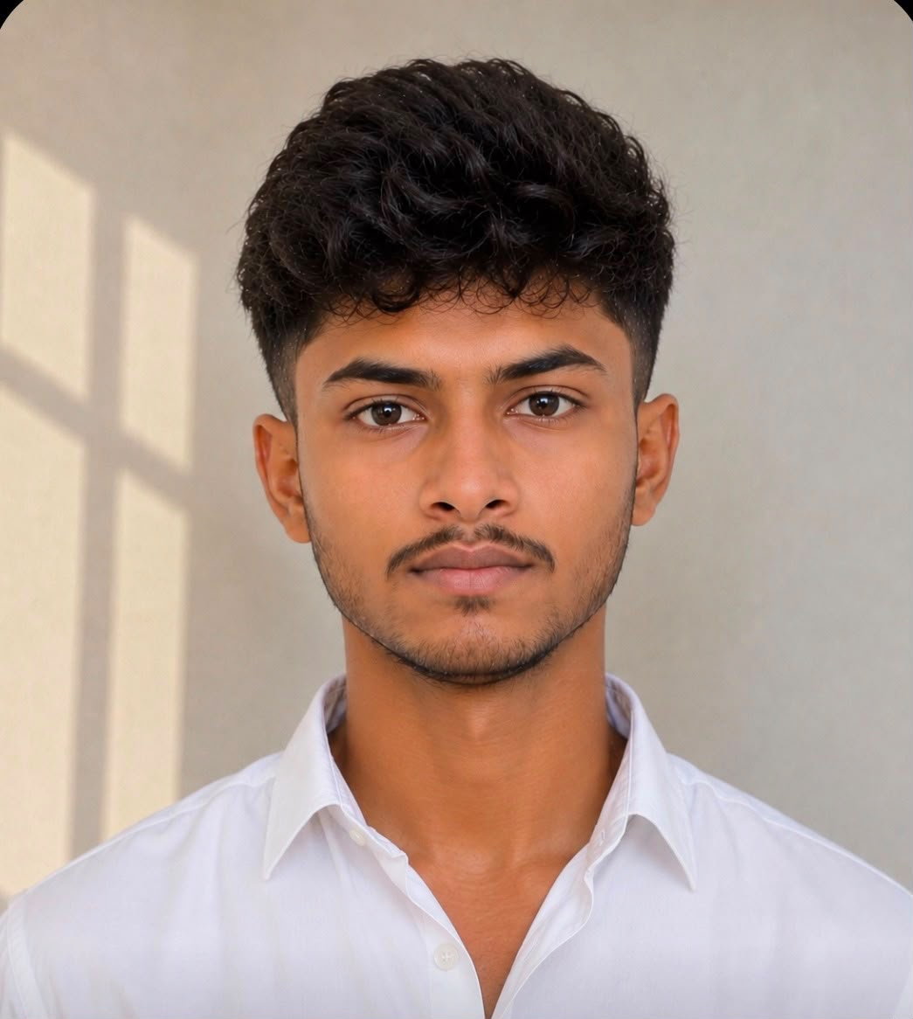
JOINT SPORTS COORIDINATOR
NAME – RISHABH
CLASS – BCA
SEMESTER - 3rd

Slide 9
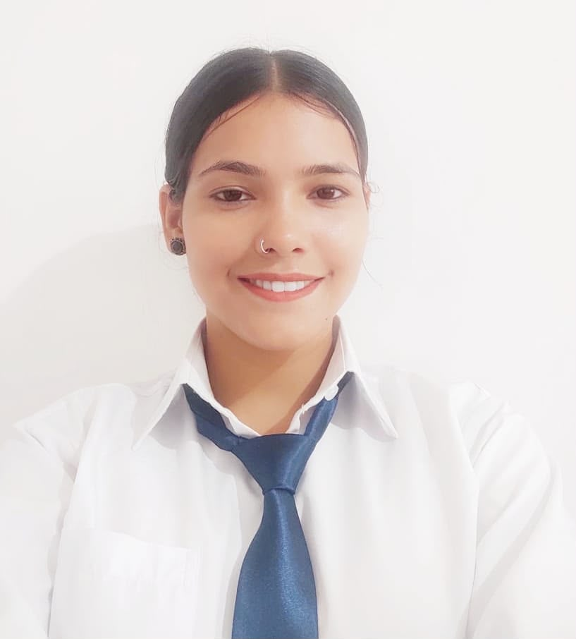
CULTURAL COORIDINATOR
NAME – GEETA
CLASS – BVTTM
SEMESTER - 3rd

Slide 10
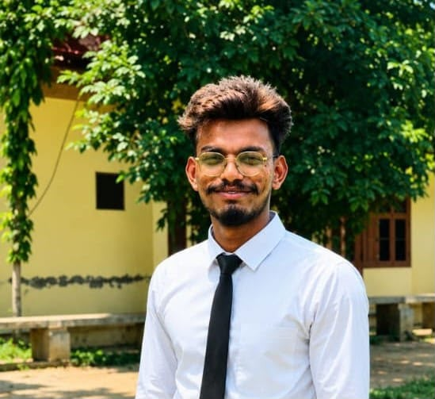
JOINT CULTURAL COORIDINATOR
NAME – HARDIK
CLASS – BSc MLS
SEMESTER - 5th

Slide 11
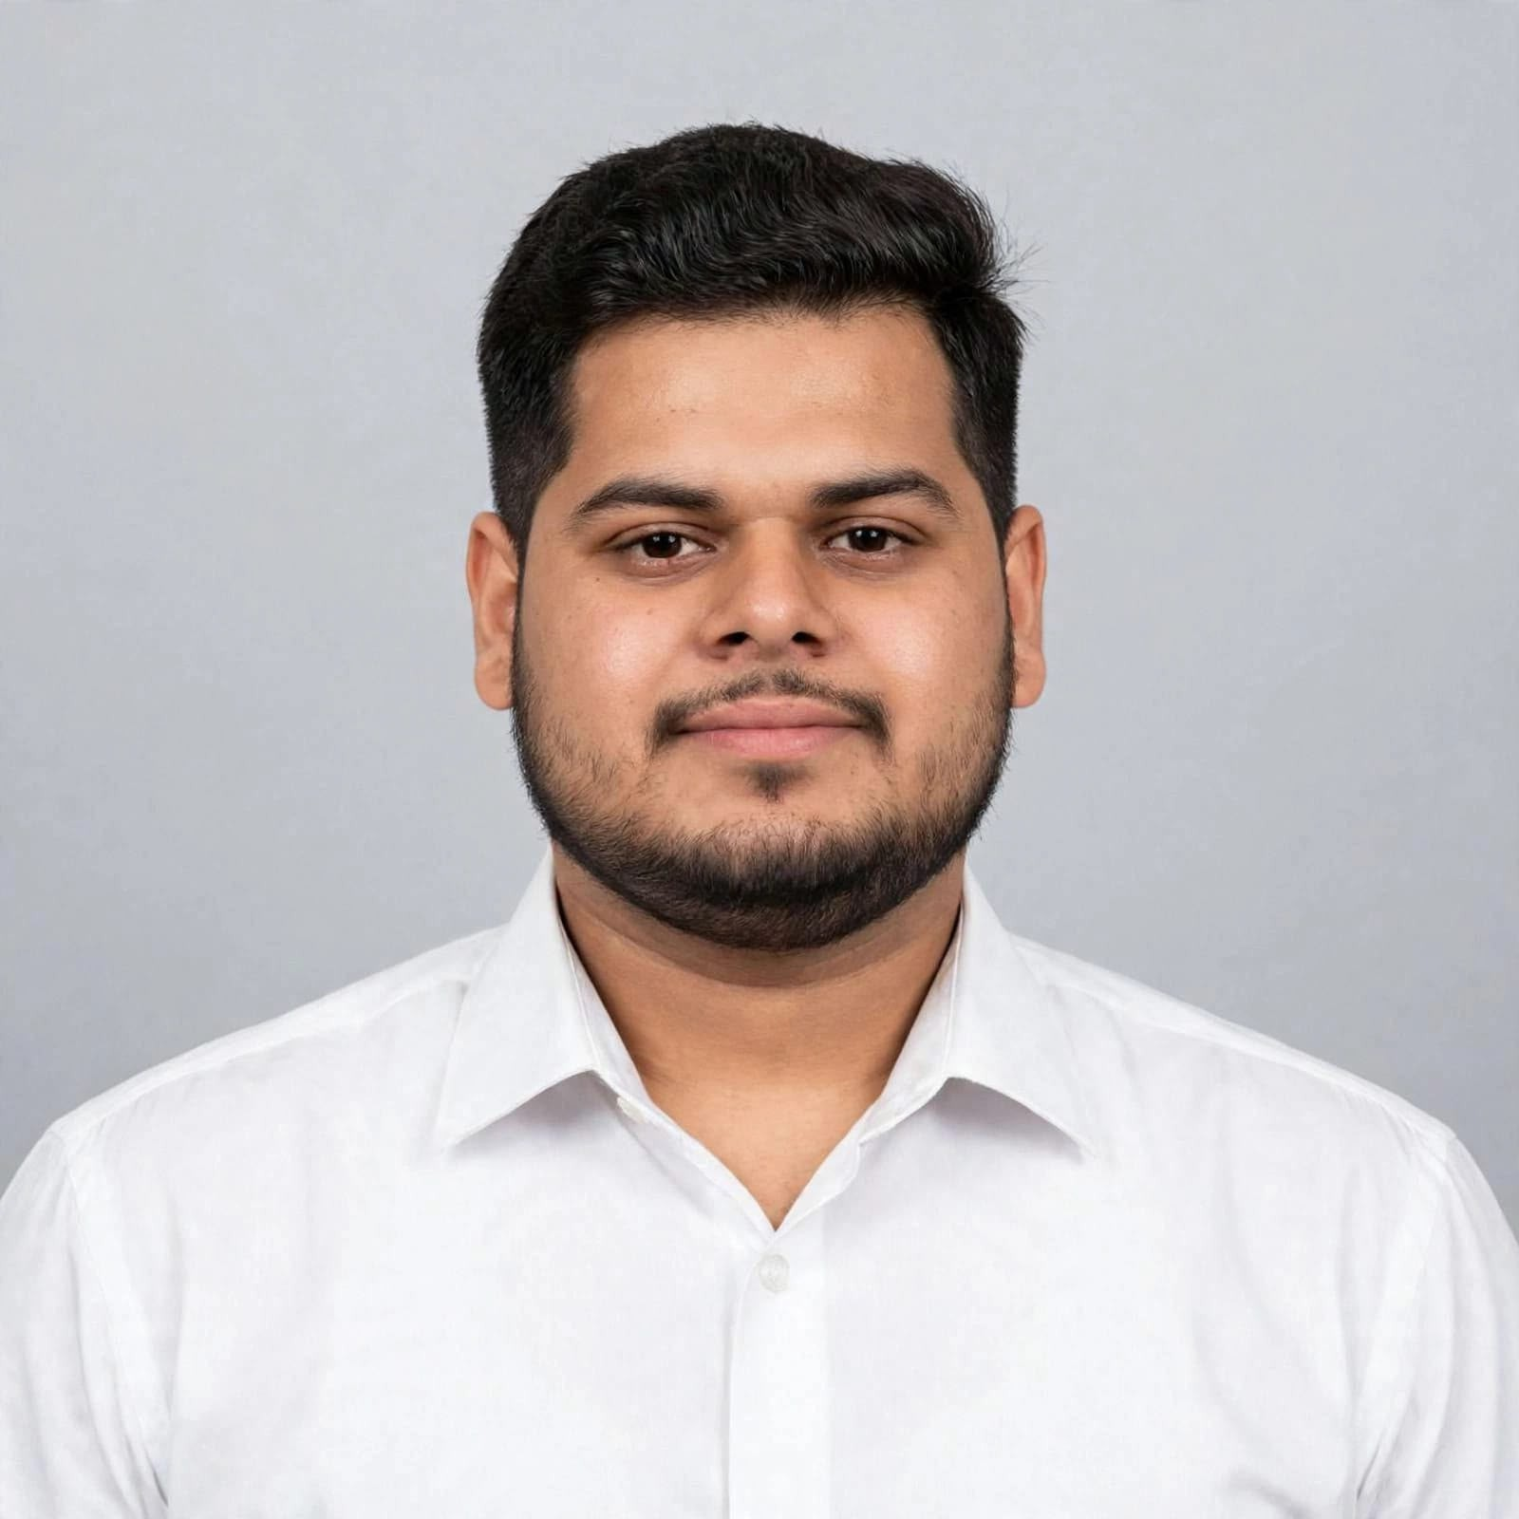
TREASURER
NAME – ARYAN
CLASS – BBA
SEMESTER - 1st

Slide 12
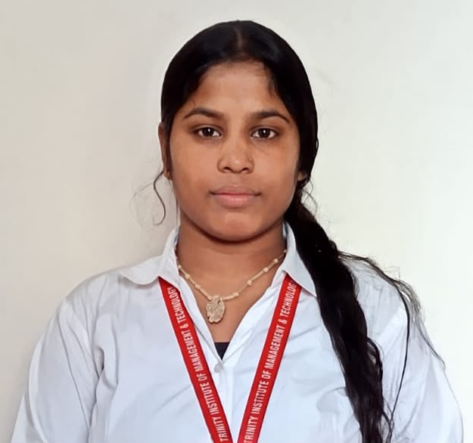
JOINT TREASURER
NAME – JYOTI
CLASS – BSc FD
SEMESTER - 5th

Slide 13
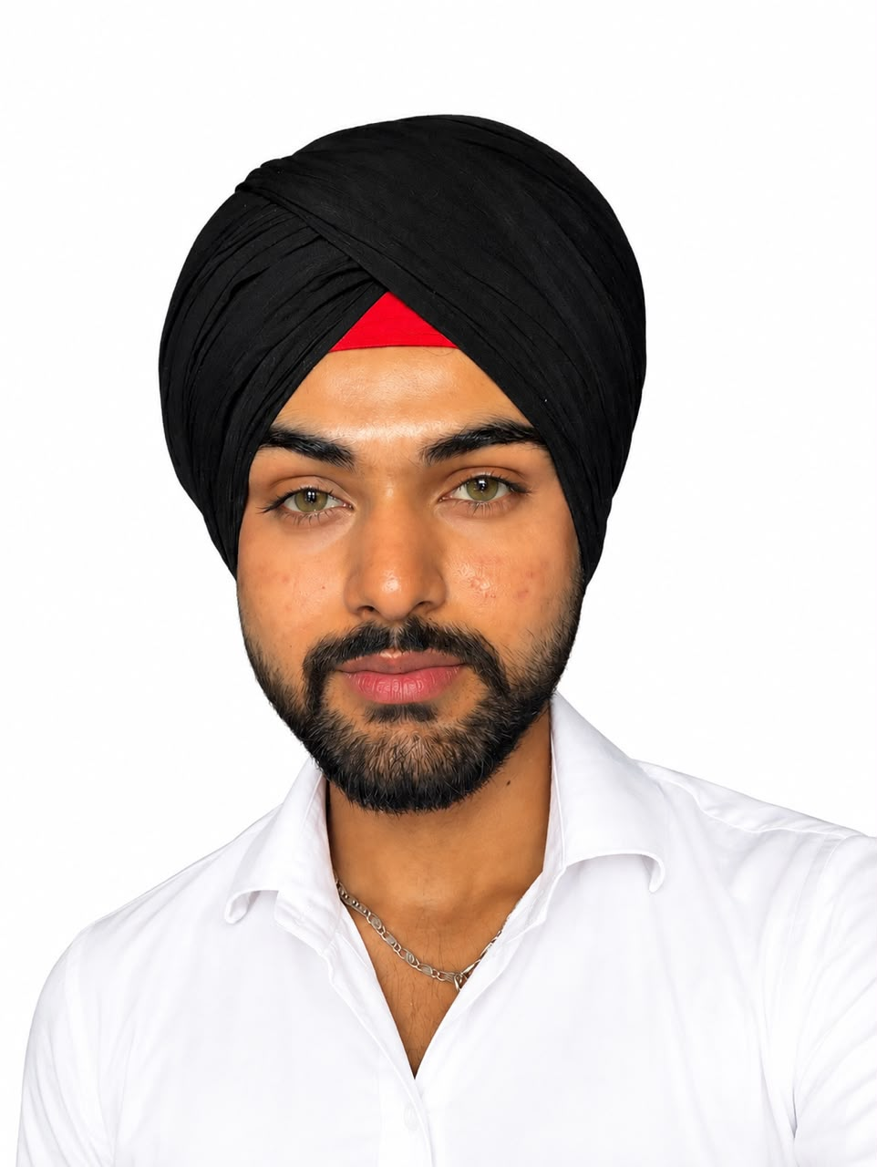
STUDENT EDITOR
NAME – PRABHDEEP SINGH
CLASS – BBA
SEMESTER - 5th

